Slide 2
Computer Networks ( KCS-603 )
UNIT-I

Slide 3
Computer Network
A computer network is a set of communicating devices connected together by communication links for the purpose of sharing resources.
Shared resources include printer, scanner and file servers etc.

Slide 4
You Require …
Components of a Computer Network

Slide 5
Benefits of Computer Network
Resource and load sharing
Programs do not need to run on a single machine
Reduced cost
Several machines can share printers, tape drives, etc.
High reliability
If a machine goes down, another can take over
Powerful Communication Medium

Slide 6
Applications of Computer Network
Business Applications
Home Applications
Access to remote information
Person-to-person communication
Interactive entertainment
Electronic commerce
Mobile Users
Social Issues

Slide 7
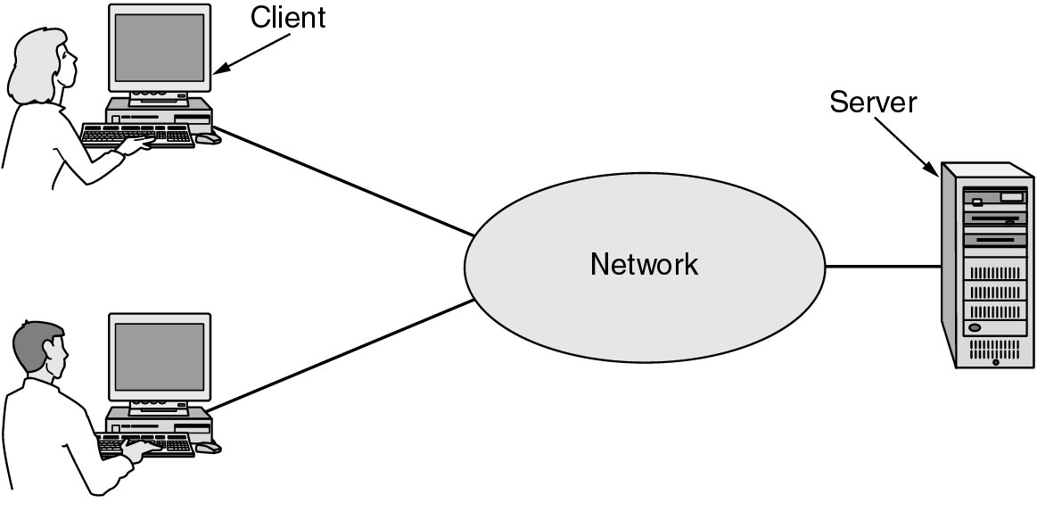
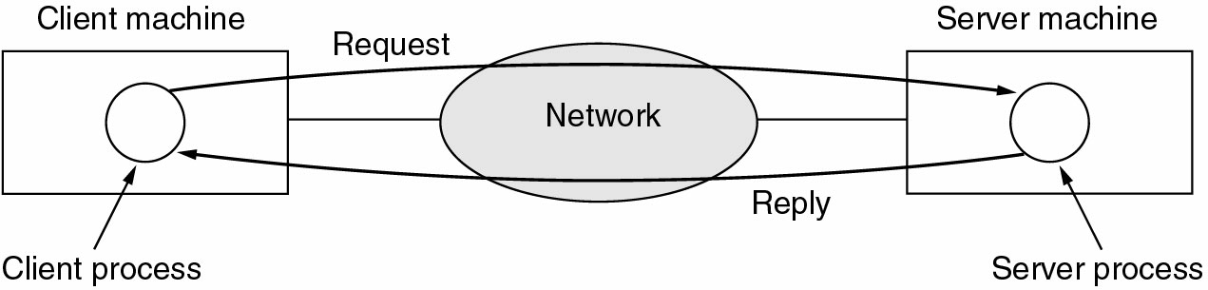
Business Applications of Networks
A network with two clients and one server. Client Server Model(Request and Reply)

Slide 8
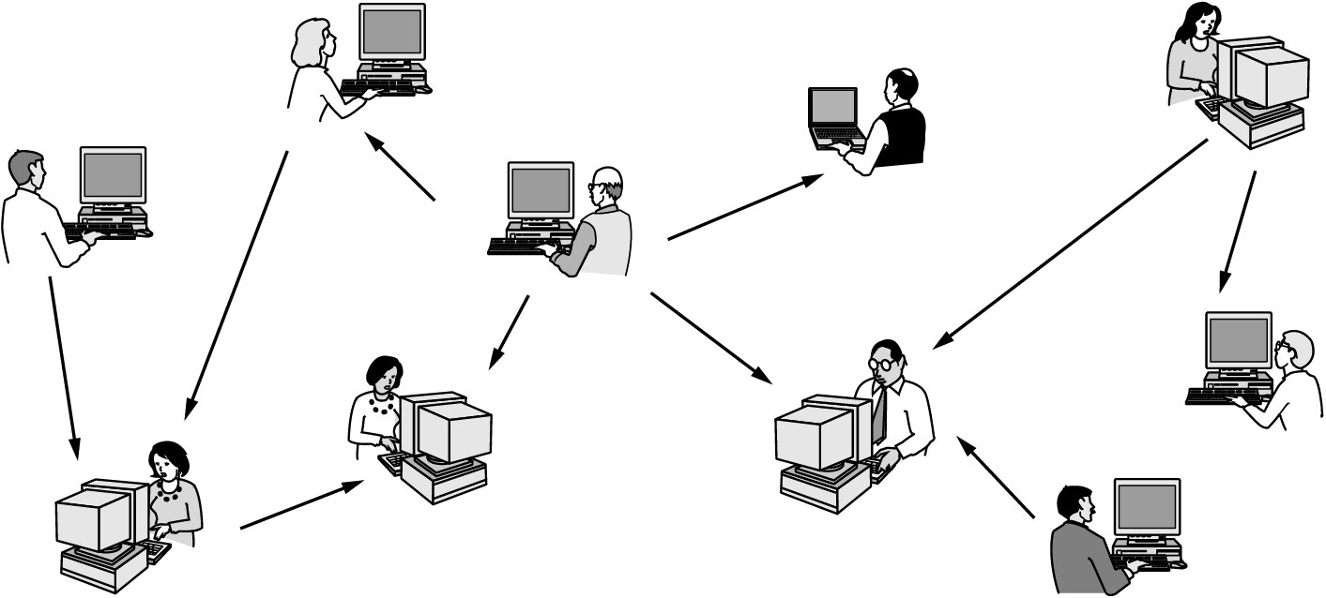
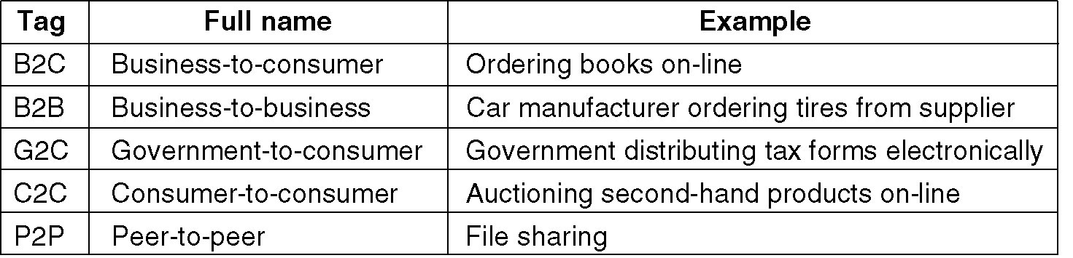
Home Network Applications
Home Network(Peer to Peer) Home Network(E-Commerce)

Slide 9
Applications of Computer Network
Business Applications
Resource Sharing: The goal is to make all programs, equipments, and especially data, available to anyone on the network without regard to the physical location of the resource and the user.
Server-Client model: One can imagine a company's information system as consisting of one or more databases and some number of employees who need to access them remotely. In this model, the data is stored on powerful computers called servers. Often these are centrally housed and maintained by a system administrator. In contrast, the employees have simple machines, called clients, on their desks, with which they access remote data.
Communication Medium: A computer network can provide a powerful communication medium among employees. Virtually every company that has two or more computers now has e-mail (electronic mail), which employees generally use for a great deal of daily communication
E-Commerce: A goal that is starting to become more important is doing business with consumers over the Internet. Airlines, bookstores and music vendors have discovered that many customers like the convenience of shopping from home. This sector is expected to grow quickly in the future.

Slide 10
Applications of Computer Network (contd.)
Home Applications
Some of the most important uses of the Internet for home users are as follows:
Access to remote information
Person-to-person communication
Interactive entertainment
Electronic commerce

Slide 11
Criteria for a Data Communication Network
Delivery- Data Delivered by sender is received by intended receiver and no one else.
Accuracy- System must deliver the data correctly. Data that has been corrupted during transmission and left uncorrected are unusable.
Timeliness- System must deliver data in a timely manner. Data delivered late is useless. Deliver data, in same order as they are produced, without significant delay.
Jitter- Variation in packet delay time. Uneven delay in delivery of adjacent packets.

Slide 12
Criteria for a Data Communication Network
Performance
Performance is defined as the rate of transferring (error free) data. It is measured by the Response Time and Transit Time.
Transit Time-Time required for data to travel from one node to another.
Response Time is the elapsed time between the end of an inquiry and the beginning of a response. Request a file transfer and start the file transfer. Factors that affect Response Time are:
Number of Users: More users on a network - slower the network will run
Transmission Speed: speed that data will be transmitted measured in bits per second (bps)
Media Type: Type of physical connection used to connect nodes together
Hardware Type: Slow computers such as XT or fast such as Pentiums
Software Program: How well is the network operating system (NOS) written
Consistency
Consistency is the predictability of response time and accuracy of data.

Slide 13
Criteria for a Data Communication Network
Reliability
Reliability is the measure of how often a network is useable. MTBF (Mean Time Between Failures) is a measure of the average time a component is expected to operate between failures. Normally provided by the manufacturer. A network failure can be: hardware, data carrying medium and Network Operating System.
Recovery
Recovery is the Network's ability to return to a prescribed level of operation after a network failure. This level is where the amount of lost data is nonexistent or at a minimum. Recovery is based on having Back-up Files.
Security
Security is the protection of Hardware, Software and Data from unauthorized access. Restricted physical access to computers, password protection, limiting user privileges and data encryption are common security methods. Anti-Virus monitoring programs to defend against computer viruses are a security measure.

Slide 14
Protocols
A protocol is a predefined way of communicating
A set of ``rules'' between processes
Example: A ``person query'' protocol
I send you the name of a person
You send me a ``yes'' or a ``no'' depending upon whether that person lives in your house
If I send anything except a name, or you reply with anything except a ``yes'' or ``no'', the protocol is broken

Slide 15
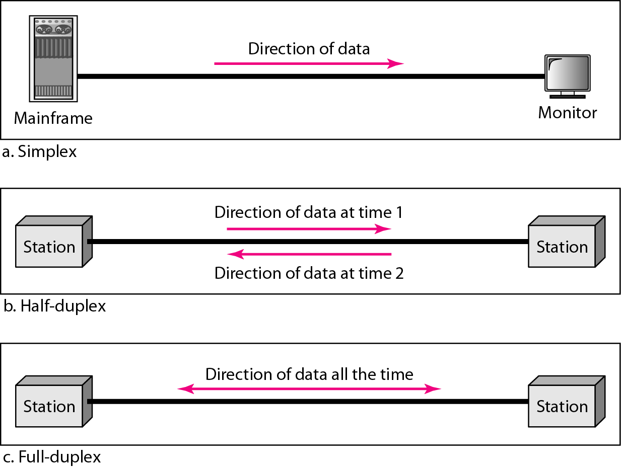
Data Flow(Simplex, Half-duplex and Full-duplex)
Example of simplex mode are: Keyboard and monitor.
Example of half duplex mode is: Walkie-Talkies.
Example of full duplex mode is:Telephone.

Slide 16
Types of Connection and Types of Transmission
Type of Connection
Point to Point - single transmitter and receiver. Bandwidth Dedicated between the two connections.
Multipoint - multiple recipients of single transmission. Bandwidth Shared between all stations on that line.
Types of Transmission(Basic)
Unicast-one sender to one receiver.
Multicast-one sender to many receivers but not all. Sending to a group having a multicast address designated by a group ID.
Broadcast-one sender to all receivers.
Types of Transmission(Derived)
Anycast- one-to-nearest association; datagrams are routed to a single member of a group of potential receivers that are all identified by the same destination address.
Geocast-delivery of information to a group of destinations in a network identified by their geographical locations. It is a specialized form of multicast addressing used by some routing protocols for mobile ad hoc networks.

Slide 17
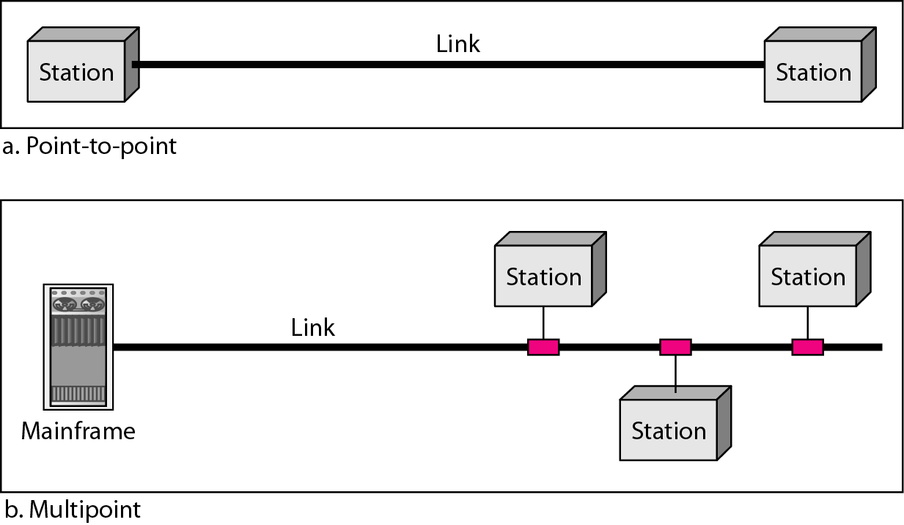
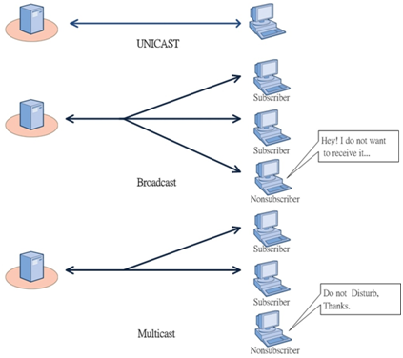
Types of Connection and Types of Transmission

Slide 18
Line Configuration
Point to Point
Multipoint

Slide 20
Network Hardware
Local Area Networks
Metropolitan Area Networks
Wide Area Networks
Wireless Networks
Wireless LANs
Wireless WANs
Home Networks
Computers (desktop PC, PDA, shared peripherals
Entertainment (TV, DVD, VCR, camera, stereo, MP3)
Telecomm (telephone, cell phone, intercom, fax)
Appliances (microwave, fridge, clock, furnace, airco)
Telemetry (utility meter, burglar alarm, babycam).
Internetworks

Slide 21
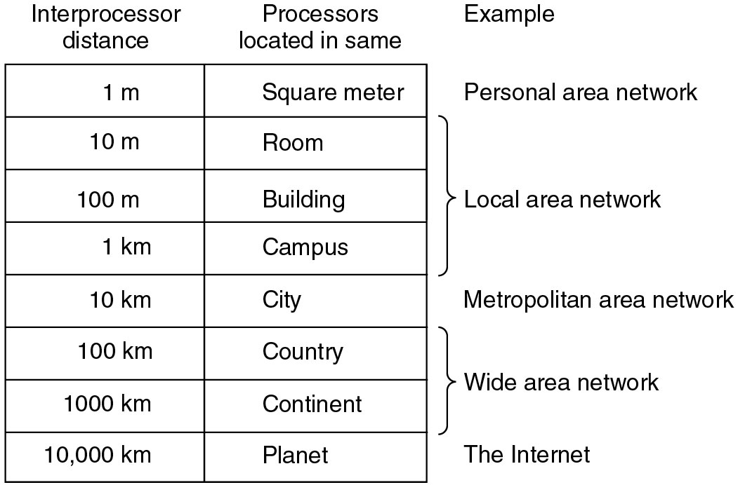
Classification of Networks By Scale

Slide 22
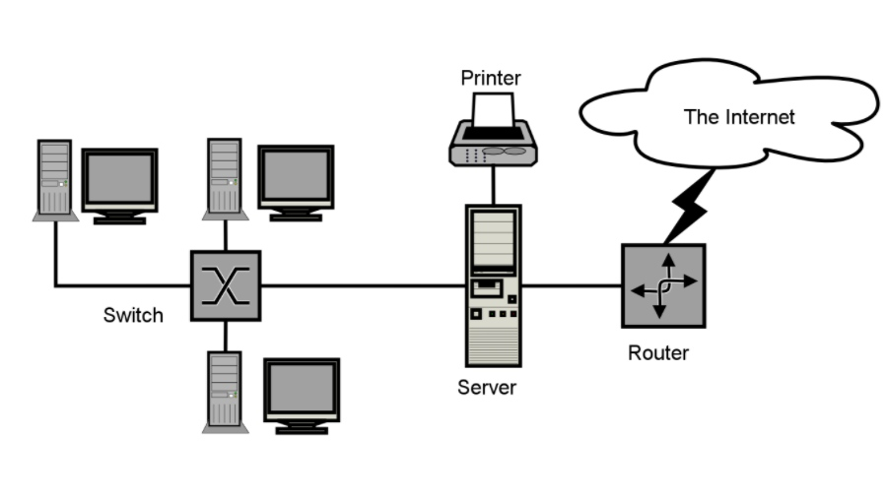
Local Area Networks
A local area network, or LAN, consists of a computer network at a single site, typically an individual office building. A LAN is very useful for sharing resources, such as data storage and printers. LANs can be built with relatively inexpensive hardware, such as hubs, network adapters and Ethernet cables.
The smallest LAN may only use two computers, while larger LANs can accommodate thousands of computers. A LAN typically relies mostly on wired connections for increased speed and security, but wireless connections can also be part of a LAN. High speed and relatively low cost are the defining characteristics of LANs.

Slide 23
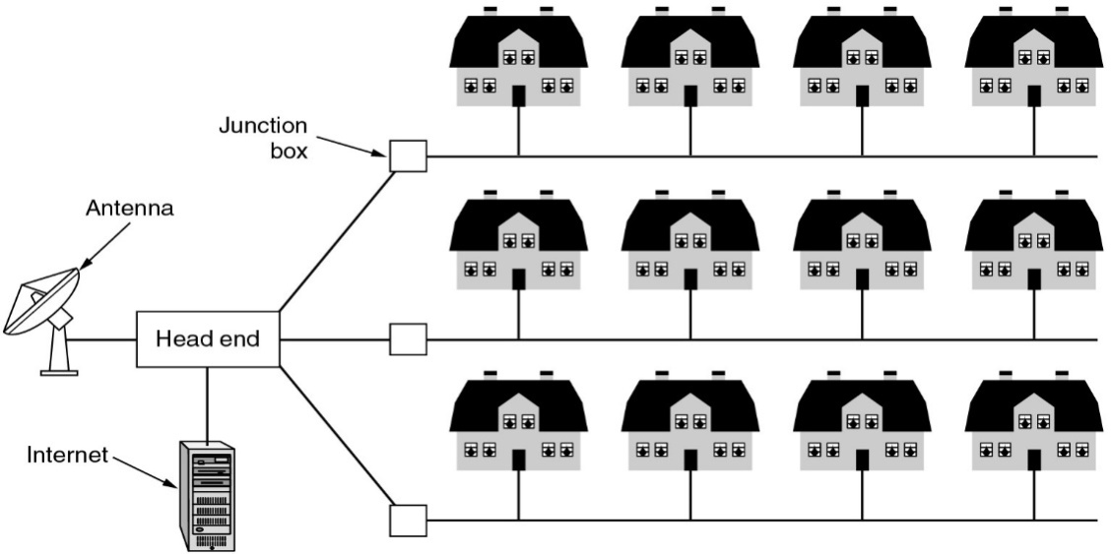
Metropolitan Area Networks - Cable TV
A metropolitan area network, or MAN, consists of a computer network across an entire city, college campus or small region. A MAN is larger than a LAN, which is typically limited to a single building or site. Depending on the configuration, this type of network can cover an area from several miles to tens of miles. A MAN is often used to connect several LANs together to form a bigger network. When this type of network is specifically designed for a college campus, it is sometimes referred to as a campus area network, or CAN.

Slide 24
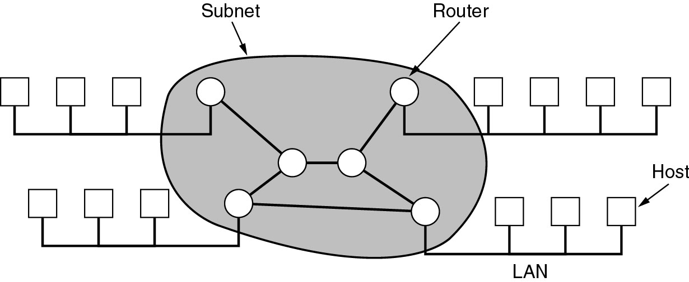
Wide Area Networks
A computer network that spans a relatively large geographical area, generally having a radius of more than 1 km. . Typically, a WAN consists of two or more local-area networks (LANs). Computers connected to a wide-area network are often connected through public networks, such as the telephone system. They can also be connected through leased lines or satellites.

Slide 25
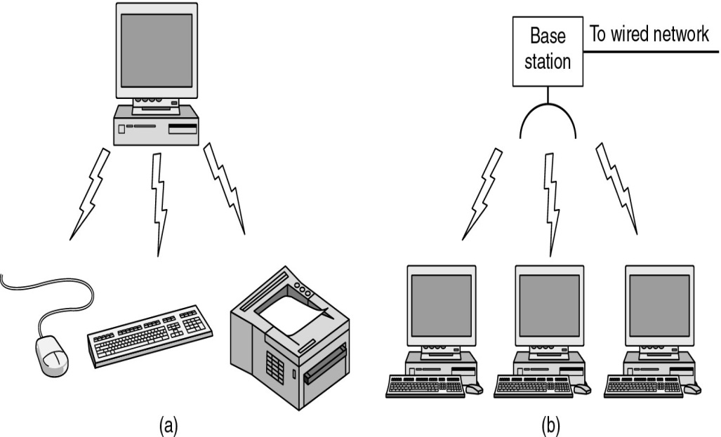
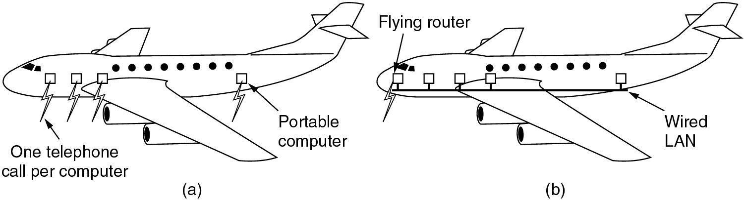
Wireless Networks
(a) Bluetooth configuration
(b) Wireless LAN
(a) Individual mobile computers
(b) A flying LAN

Slide 26
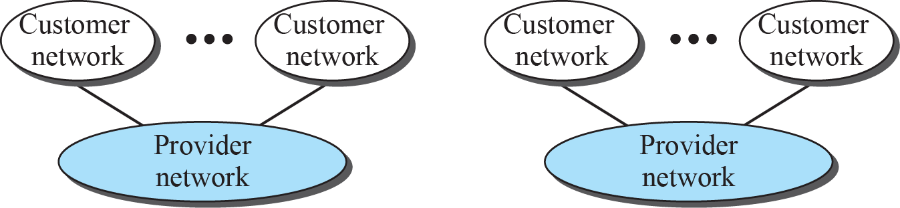
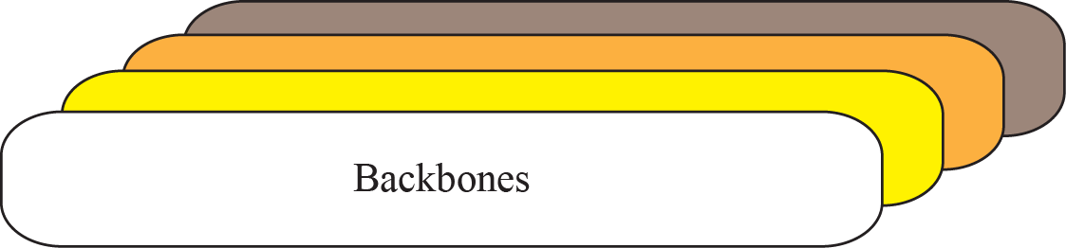
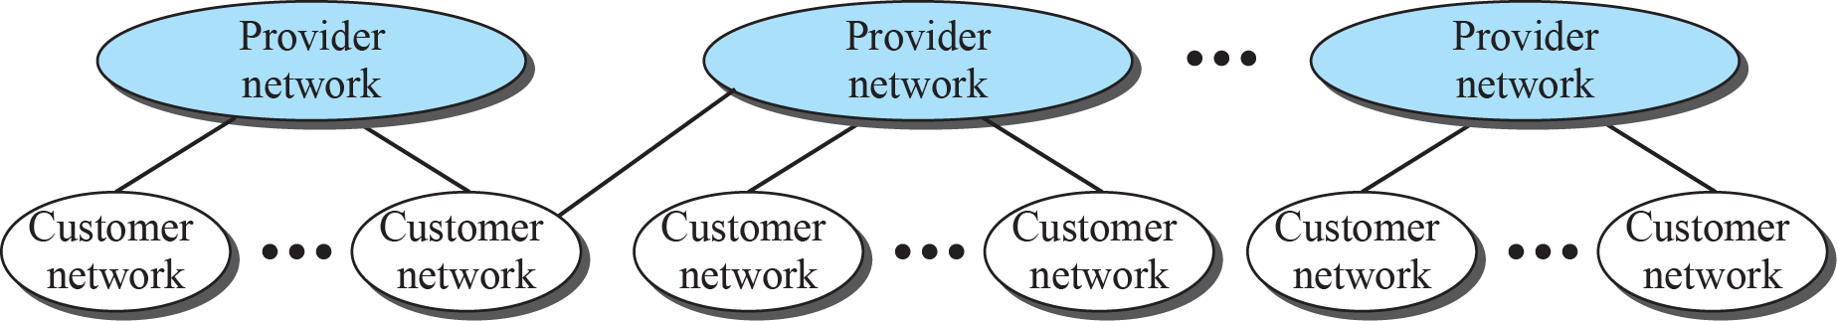
The Internet today
The Internet today is an internetwork that allows any user to become part of it. The user, however, needs to be physically connected to an ISP. The physical connection is normally done through a point-to-point WAN.
1.26

Slide 27
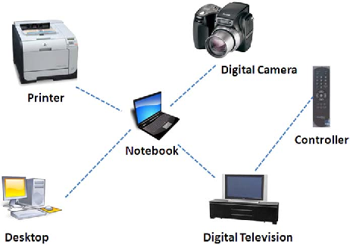
PAN (Personal Area Network)
Some newer types of the networks based on their reach
A personal area network (PAN) is a computer network used for data transmission amongst devices such as computers, telephones, tablets, personal digital assistants, fax machines and printers, that are located close to a single user.

Slide 28
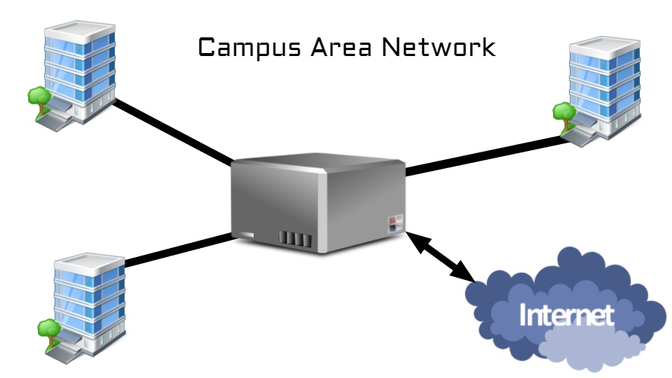
CAN (Campus Area Network)
A network infrastructure covering the school, university, or a corporate premises can be dubbed as campus area network. It can comprise of several LANs, a central firewall, and connected to the internet using a leased line or any other means.

Slide 29
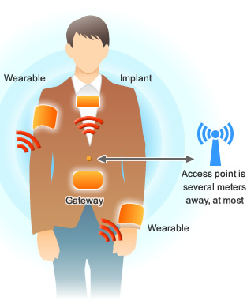
BAN (Body Area Network)
Related to PAN ( as a subnetwork ), another term BAN is used for using wearable devices like smartwatches, fitness bands, biometric RFID implants, and medical devices placed inside the body like pacemakers. Wireless BAN is the primary form used to created such networks. It is defined as per the IEEE 802.15.6 standard which describes a short-range, extremely low power wireless communication within or in a vicinity of the human body.
Wireless BAN can work together with PAN technologies. For instance, a Bluetooth-connected smartphone can be used to sync data from wearables and various sensors present in the body.

Slide 30
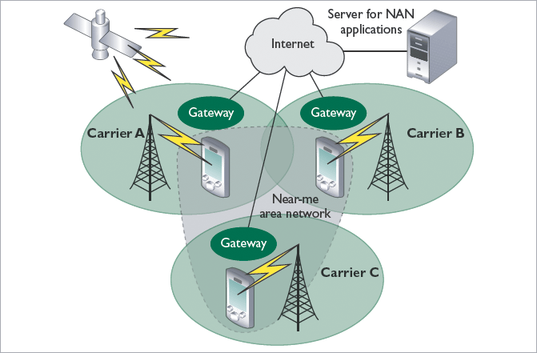
NAN (Near-Me Network)
Although it sounds totally unfamiliar, you use Near-me network almost every day. Remember chatting with your friends on Facebook while all of you were sitting in the same room. You were part of a NAN, even though you might be on the networks of different carriers.
A message from your device would traverse all the way to Facebook servers over the internet come to your friend’s device sitting right next to you. In a logical way, both the device are on some sort of network. Basically, the criteria for the devices is to lie in proximity. They don’t need to be connected to the same network. For instance, they can be connected via WiFi, cellular, etc.

Slide 31
Brief description of some other terms discussed in lectures
Firewall
A firewall is software used to maintain the security of a private network. Firewalls block unauthorized access to or from private networks and are often employed to prevent unauthorized Web users or illicit software from gaining access to private networks connected to the Internet. A firewall may be implemented using hardware, software, or a combination of both.

Slide 32
Proxy Server
Most large businesses, organizations, and universities these days use a proxy server. This is a server that all computers on the local network have to go through before accessing information on the Internet. By using a proxy server, an organization can improve the network performance and filter what users connected to the network can access.
A proxy server improves Internet access speeds from a network primarily by using a caching system. Caching saves recently viewed Web sites, images, and files on a local hard drive so that they don't have to be downloaded from the Web again. While your Web browser might save recently viewed items on your computer, a proxy server caches everything accessed from the network. Though this means super-fast access to Web pages, it also means users might not be seeing the latest update of each Web page.
The other main purpose a proxy server is to filter what is allowed into the network. While HTTP, FTP, and Secure protocols can all be filtered by a proxy server, HTTP is the most common. The proxy server can limit what Web sites users on the network can access. Many organizations choose to block access to sites with objectionable material, but other sites can be filtered as well.

Slide 33
IP Address
Most An IP address, short for Internet Protocol address, is an identifying number for a piece of network hardware. Having an IP address allows a device to communicate with other devices over an IP-based network like the internet.
Most IP addresses look like this: 151.101.65.121
MAC Address
MAC (Media Access Control) address [often referred to as hardware or physical address ] is your computer's unique hardware number. (On an Ethernet LAN, it's the same as your Ethernet address.)
When you're connected to the Internet from your computer (or host as the Internet protocol thinks of it), a correspondence table relates your IP address to your computer's physical (MAC) address on the LAN.
MAC addresses are 6-byte (48-bits) in length, and are written in MM:MM:MM:SS:SS:SS format as . The first 3-bytes are ID number of the manufacturer, which is assigned by an Internet standards body. The second 3-bytes are serial number assigned by the manufacturer.

Slide 34
IP Address
Most An IP address, short for Internet Protocol address, is an identifying number for a piece of network hardware. Having an IP address allows a device to communicate with other devices over an IP-based network like the internet.
Most IP addresses look like this: 151.101.65.121
MAC Address
MAC (Media Access Control) address [often referred to as hardware or physical address ] is your computer's unique hardware number. (On an Ethernet LAN, it's the same as your Ethernet address.)
When you're connected to the Internet from your computer (or host as the Internet protocol thinks of it), a correspondence table relates your IP address to your computer's physical (MAC) address on the LAN.
MAC addresses are 6-byte (48-bits) in length as 12-digit hexadecimal numbers, and are written in MM:MM:MM:SS:SS:SS format . The first 3-bytes are ID number of the manufacturer, which is assigned by an Internet standards body. The second 3-bytes are serial number assigned by the manufacturer. Sample MAC Address: 00:1C:B3:09:85:15

Slide 35
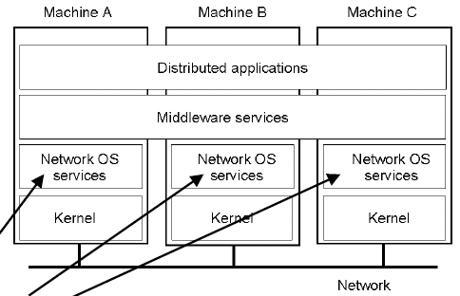
Distributed Systems
Distributed System built on top of Heterogenous Networks to provide Transparency to user.
Ex- Distributed Unix
Wide area network applications
email - electronic mail
bbs - bulletin board systems
netnews - group discussions on single subject
gopher - text retrieval service
WWW - world wide web
Banking applications like Finnacle, Bancslink.
Middleware Programming Platforms
CORBA
Java Sun-RPC

Slide 36
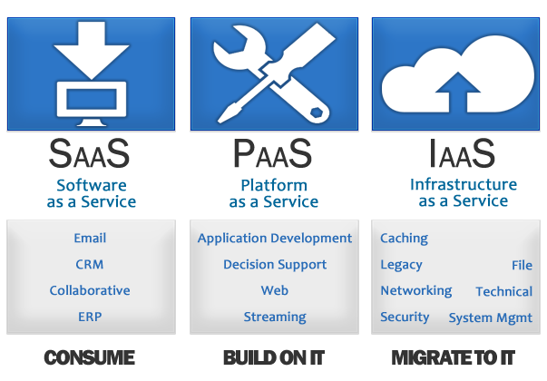
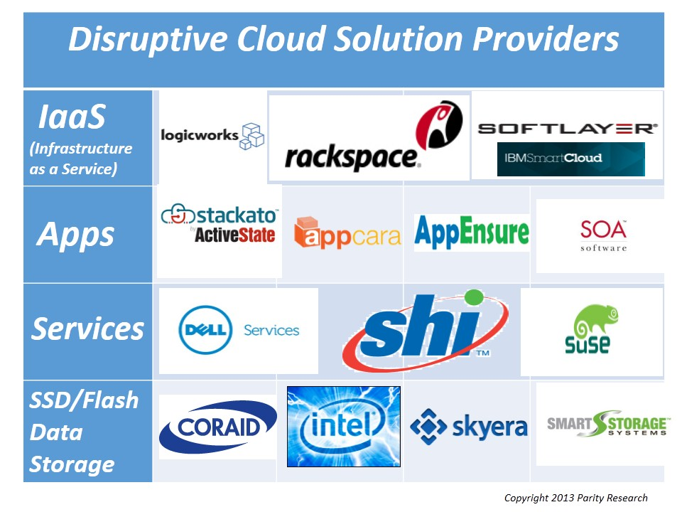
Cloud Computing
The practice of using a network of remote servers hosted on the Internet to store, manage, and process data, rather than a local server or a personal computer.
Ex-Microsoft Azure, Amazon Web Services, Oracle Web-Cloud etc.

Slide 37
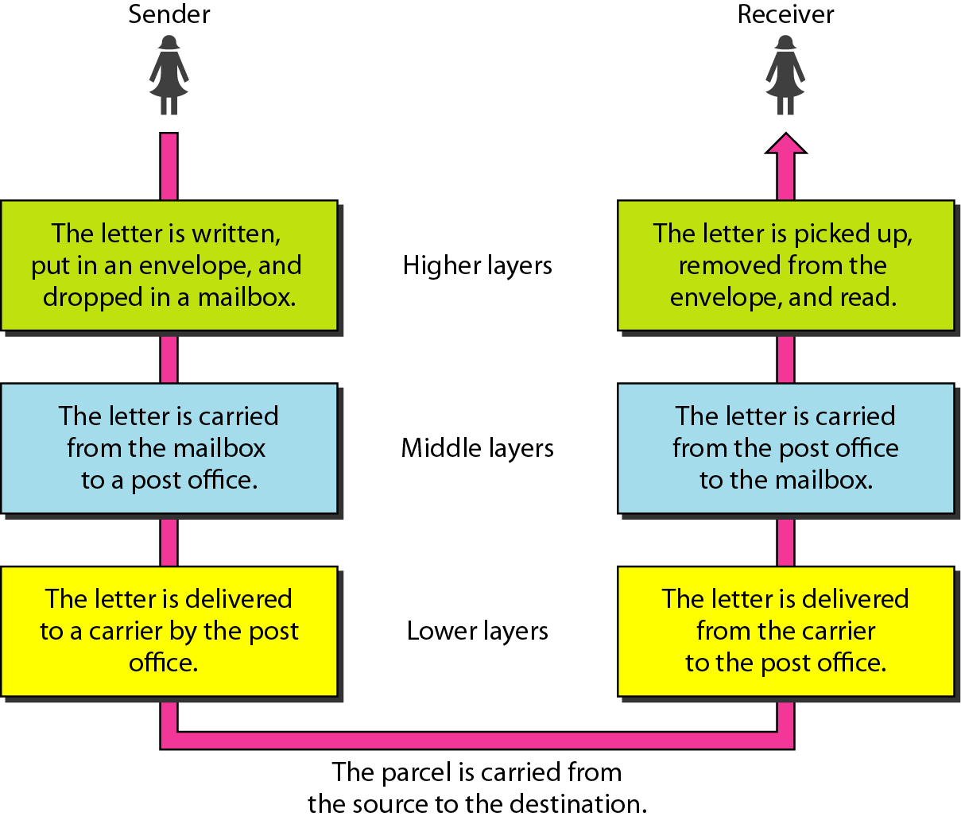
Basic Message Communication System
Tasks involved in sending a letter

Slide 38
Network Software
Protocol Hierarchies
Design Issues for the Layers
Connection-Oriented and Connectionless Services
Service Primitives
The Relationship of Services to Protocols

Slide 39
Network Software Protocol Hierarchies
To reduce the design complexity, most of the networks are organized as a series of layers or levels, each one build upon one below it.
The basic idea of a layered architecture is to divide the design into small pieces.
Each layer adds to the services provided by the lower layers in such a manner that the highest layer is provided a full set of services to manage communications and run the applications.
The benefits of the layered models are modularity and clear interfaces, i.e. open architecture and comparability between the different providers' components.

Slide 40
Element of layered model
A service is a set of actions that a layer offers to another (higher) layer.
Protocol is a set of rules that a layer uses to exchange information with a peer entity. These rules concern both the contents and the order of the messages used.
Between the layers service Interfaces are defined. The messages from one layer to another are sent through those interfaces.

Slide 41
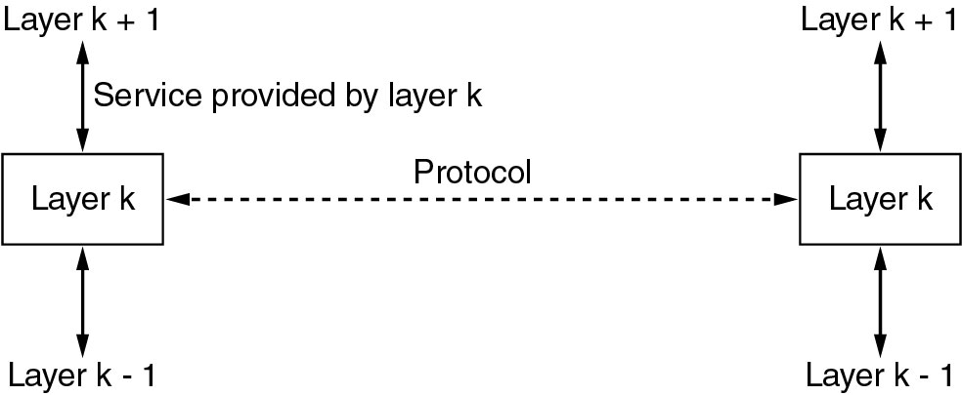
Services to Protocols Relationship
The relationship between a service and a protocol.
Layer k/k+1 Interface
Layer k-1/k Interface

Slide 42
Design Issues for the Layers
Addressing
Error Control
Flow Control
Multiplexing
Routing

Slide 43
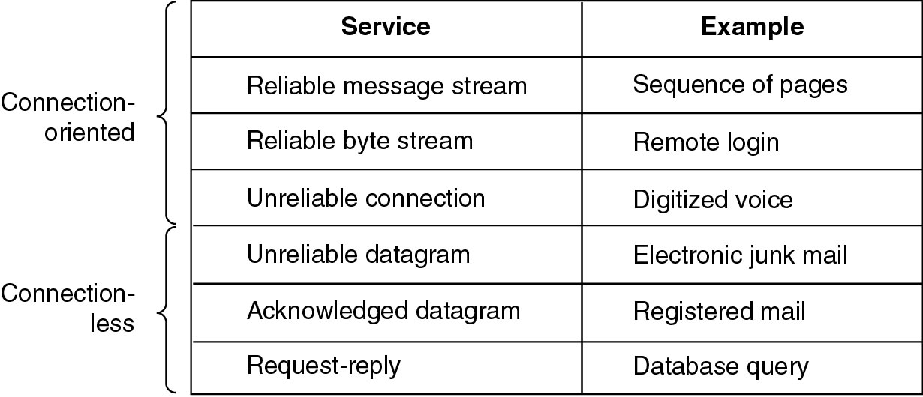
Connection-Oriented and Connectionless Services
Six different types of service.

Slide 44
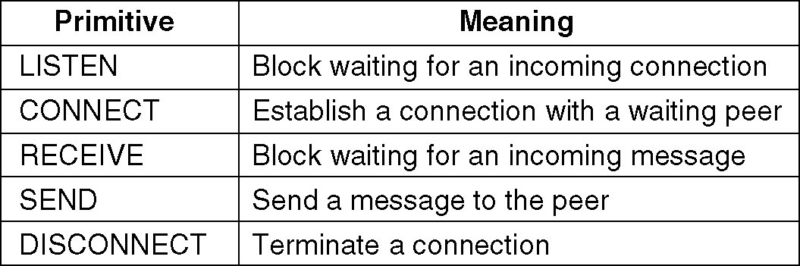
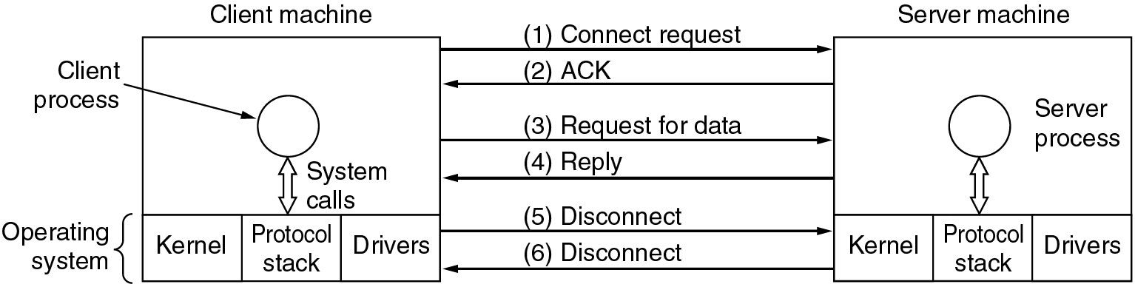
Service Primitives in a Connection-Oriented Service
Five service primitives for implementing a simple connection-oriented service.
Packets sent in a simple client-server interaction on a connection-oriented network.

Slide 45
Reference Models
The OSI Reference Model
The TCP/IP Reference Model
A Comparison of OSI and TCP/IP
A Critique of the OSI Model and Protocols
A Critique of the TCP/IP Reference Model

Slide 46
OSI and TCP/IP model-Brief History
Established in 1947, International Organization for Standardization (ISO) is a multinational body dedicated to worldwide agreement on international standards. An ISO standard that covers all aspects of network communications is the Open Systems Interconnection (OSI) model. It was first introduced in the late 1970s.
TCP/IP is a protocol suite used in the Internet today. It is a hierarchical protocol made up of interactive modules, each of which provides a specific functionality. The term hierarchical means that each upper level protocol is supported by the services provided by one or more lower level protocols. The original TCP/IP protocol suite was defined as four software layers built upon the hardware. Today, however, TCP/IP is thought of as a five-layer model.
ISO is the organization. OSI is the model.

Slide 47
Motivation behind layer model
To reduce the design complexity, most of the networks are organized as a series of layers or levels, each one build upon one below it.
The basic idea of a layered architecture is to divide the design into small pieces.
Each layer adds to the services provided by the lower layers in such a manner that the highest layer is provided a full set of services to manage communications and run the applications.
The benefits of the layered models are modularity and clear interfaces, i.e. open architecture and comparability between the different providers' components.

Slide 48
THE OSI MODEL
Established in 1947, the International Organization for Standardization (ISO) is a multinational body dedicated to worldwide agreement on international standards. An ISO standard that covers all aspects of network communications is the Open Systems Interconnection (OSI) model. It was first introduced in the late 1970s.
Note:
ISO is the organization.
OSI is the model.

Slide 49
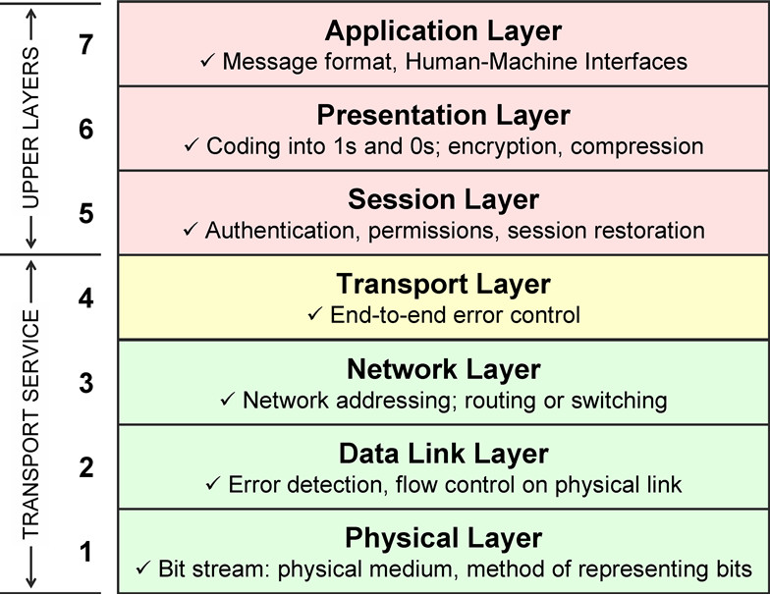
Seven layers of the OSI model

Slide 50
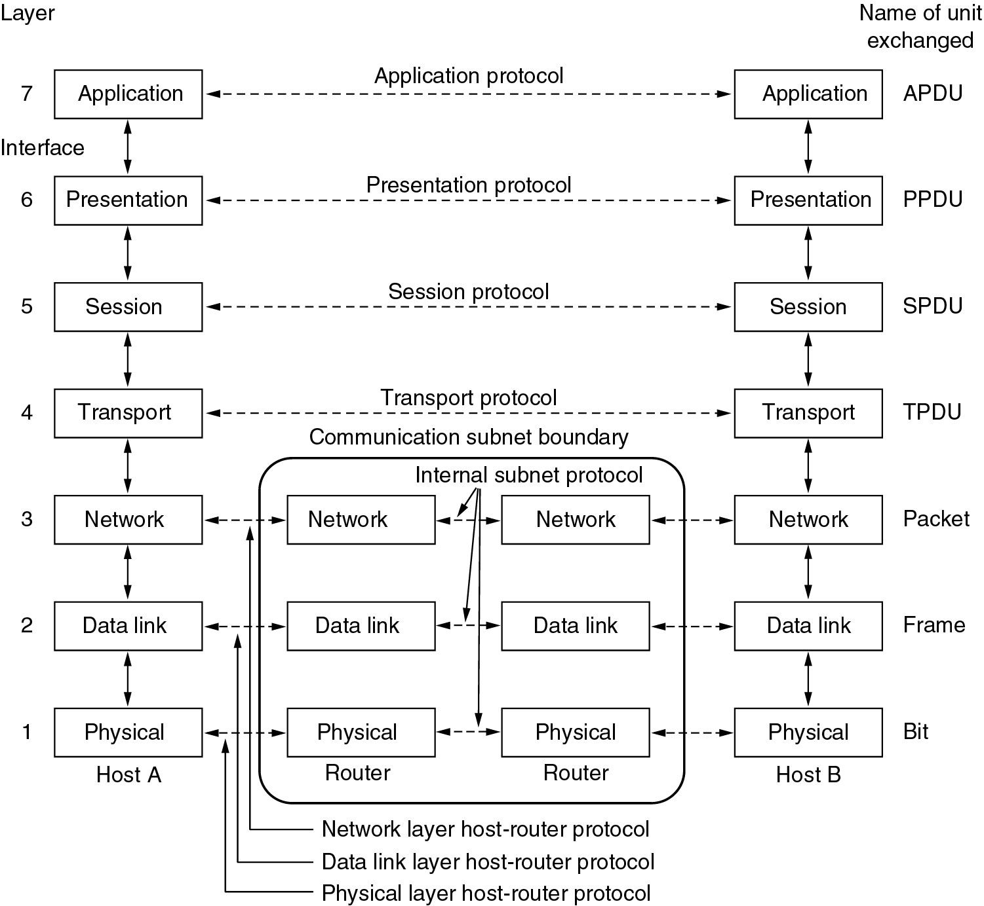
Reference Models-The OSI Reference Model
*PDU=
Protocol Data Unit
PDU has four fields:
1.the destination service access point
2.source service access point, 3.control field
and
4.information field.
(Segment)

Slide 51
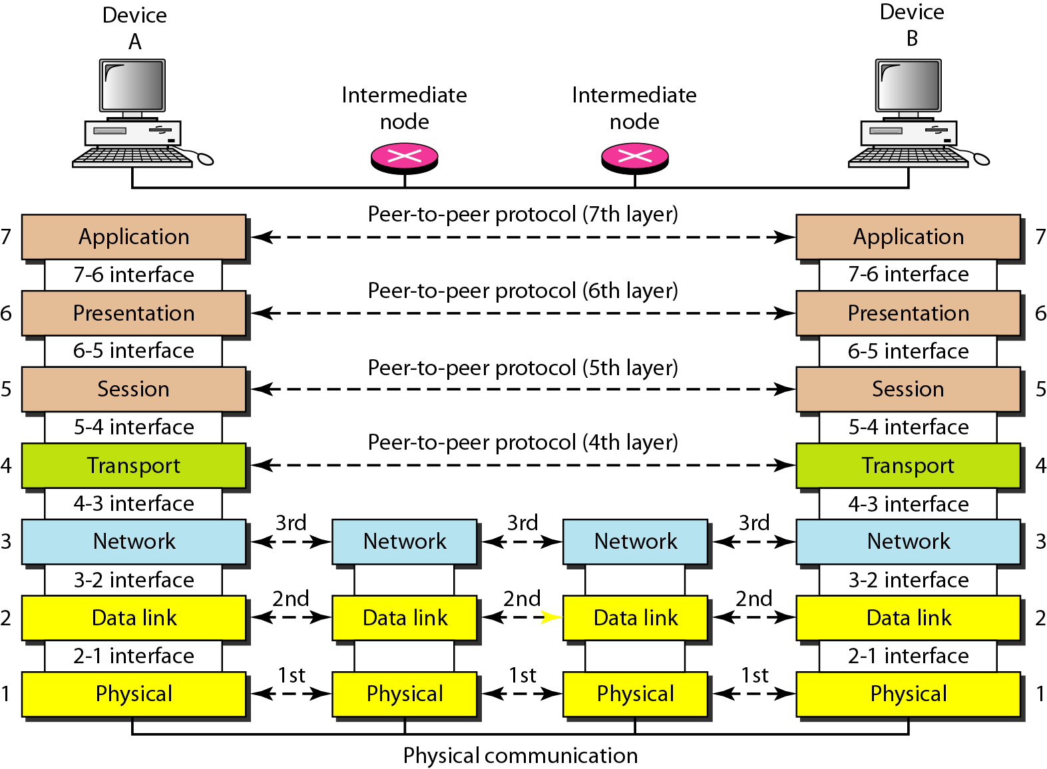
Interfaces b/w Layers

Slide 52
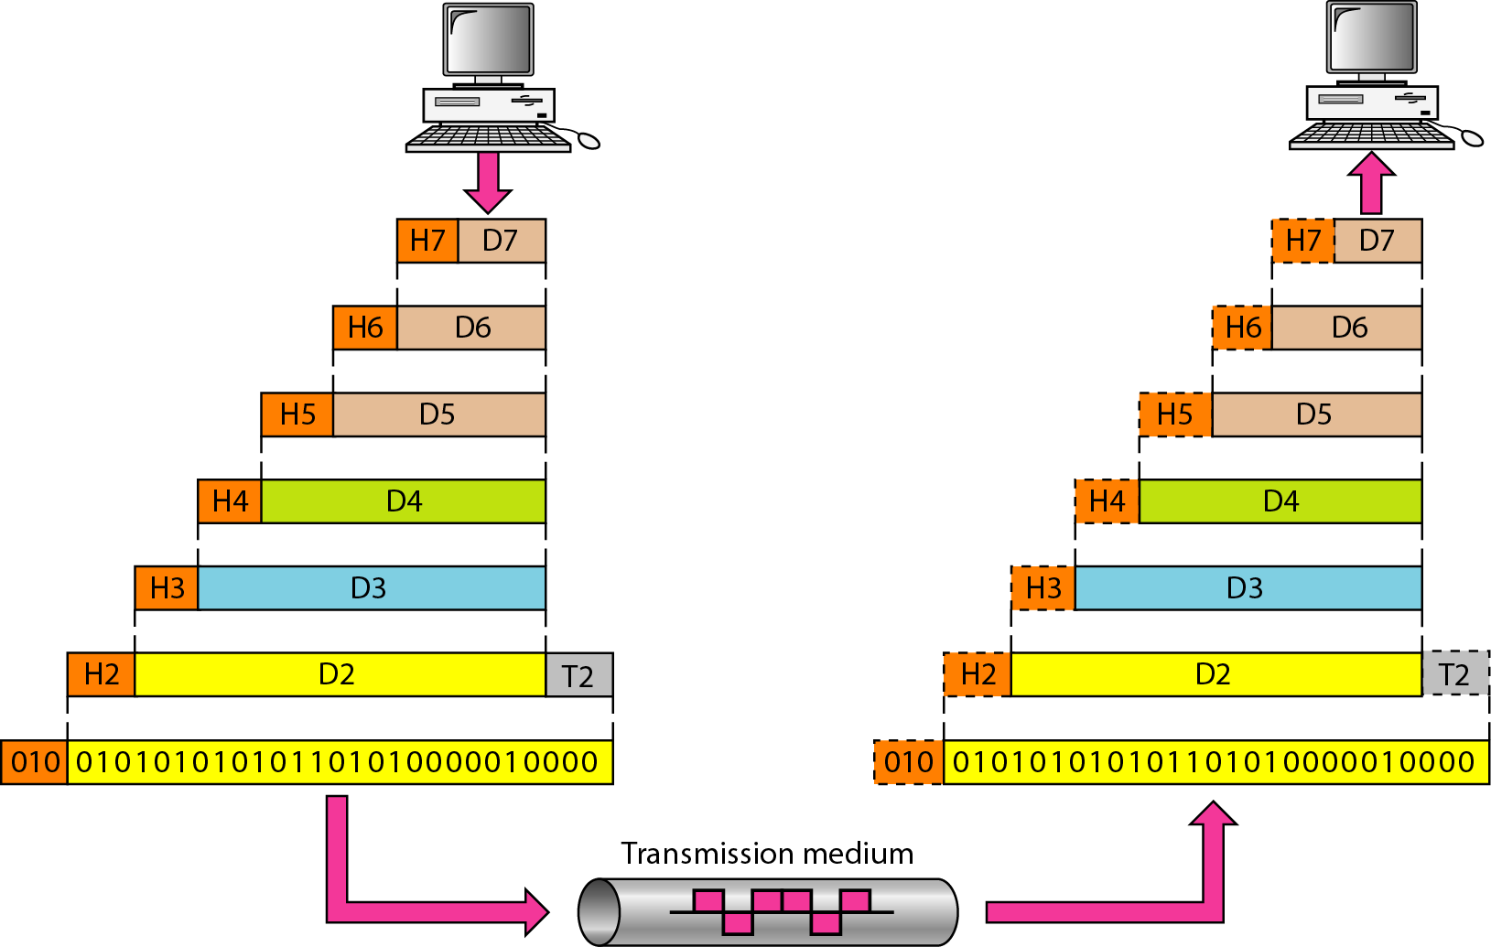
Exchange using the OSI Model

Slide 53
Physical Layer
The physical layer is responsible for movements of individual bits from one hop (node) to the next.
It is a fundamental layer underlying the higher level functions in a network. Due to large variety of available hardware technologies with widely varying characteristics, this is perhaps the most complex layer in the OSI architecture.
Physical characteristics of interface and medium:
pin assignment, connector, cables
Representation of bits: encoding
Data rate
Synchronization of bits
Line configuration: point-to-point, multipoint
Physical topology
Transmission mode: simplex, half-duplex, full-duplex

Slide 54
Physical Layer
Cabling Protocols (crossover, 100BaseT & more)
802.3 Ethernet
802.11 Wireless Used,
USB,
Bluetooth
ADSL (Asymmetric digital subscriber line)
ISDN (Integrated Services Digital Network)
SONET (Synchronous Optical NETworking)

Slide 55
Data Link Layer
The data link layer is responsible for moving frames from one hop (node) to the next.
MAIN FUCTIONS:
Framing Physical addressing Flow control Error control Access control
PROTOCOLS USED
LLC (Logical Link Control), MAC(Media Access Control), ATM, Frame Relay, Token Ring, FDDI (Fiber Distributed Data Interface) and more…

Slide 56
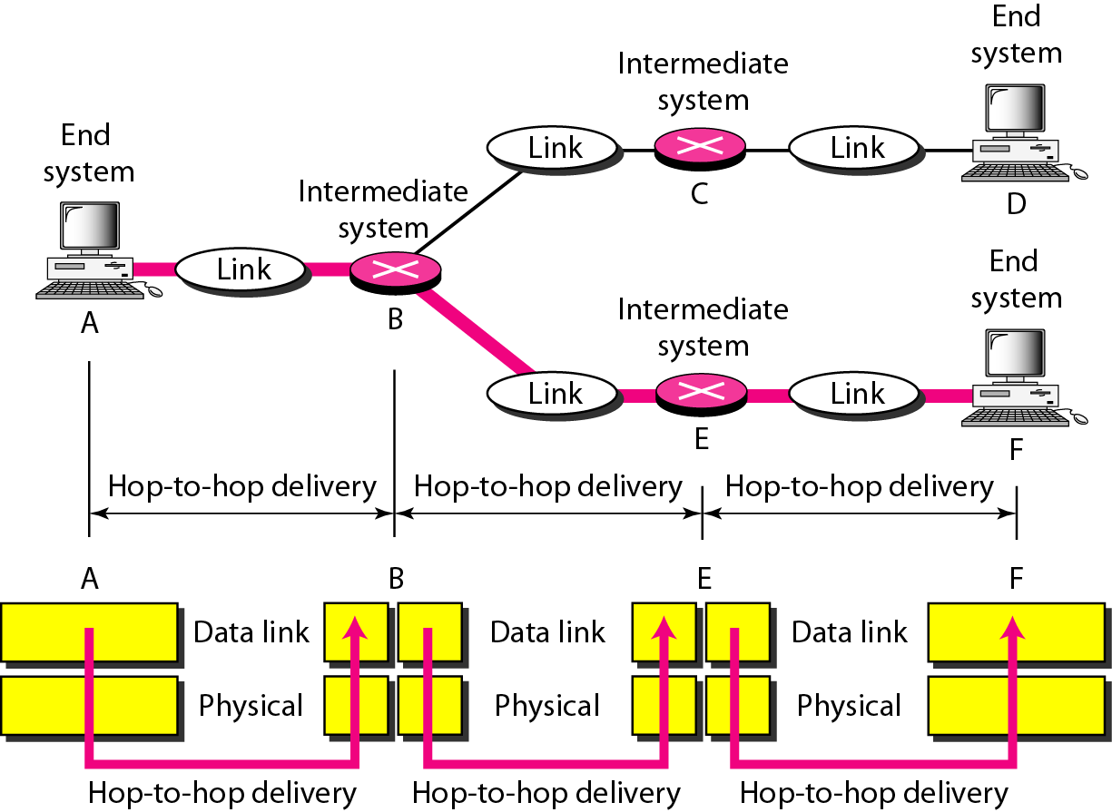
Hop-to-hop Delivery

Slide 57
Network Layer
Main function of Network Layer is to move packets from source to destination in an efficient manner (called routing), e.g., along the shortest path, and to provide internetworking of different
network types (a key service is address resolution across different networks or network layers).
PROTOCOLS USED
IPv4 IPv6 ICMP (Internet Control Message Protocol) IGMP (Internet Group Management Protocol) RIP (Routing Information Protocol) ARP (Address Resolution Protocol) RARP (Reverse Address Resolution Protocol) IPX (Internetwork Packet Exchange) BGP(Border Gateway Protocol)
MAIN FUNCTIONS
Logical addressing (IP Addressing) Routing

Slide 58
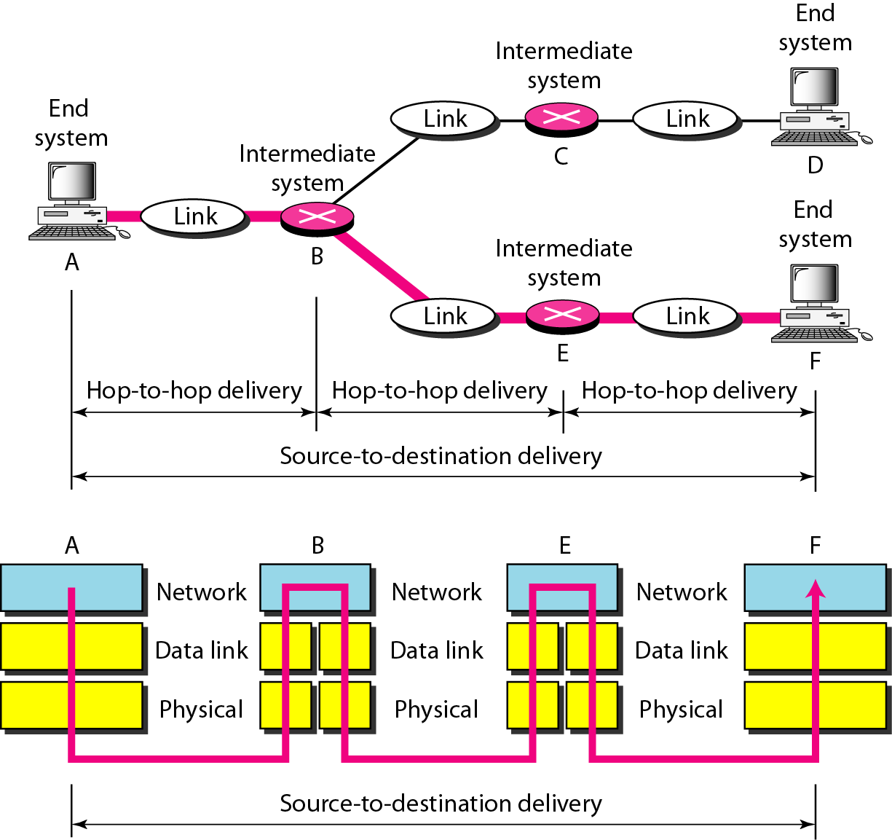
Source-to-destination delivery

Slide 59
Transport layer
The transport layer is responsible for the delivery of a message from one process to another.
Service-point addressing
Segmentation and reassembly
Connection control
Flow control
Error control
PROTOCOLS USED
TCP (Transmission Control Protocol)
UDP (User Datagram Protocol)
SCTP (Stream Control Transmission Protocol)

Slide 60
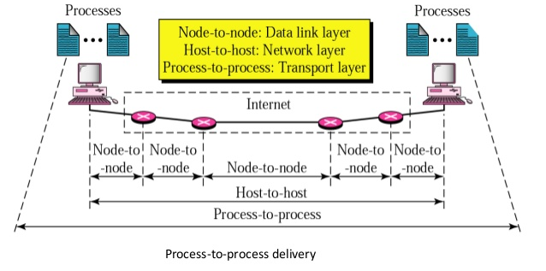
Transport layer

Slide 61
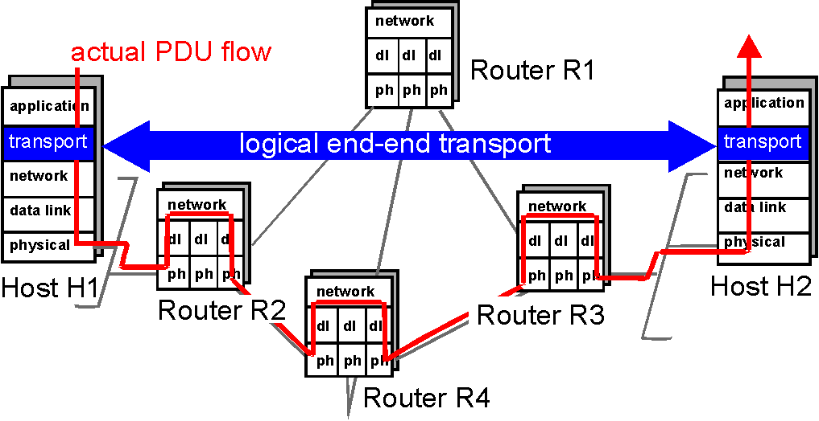
Transport layer

Slide 62
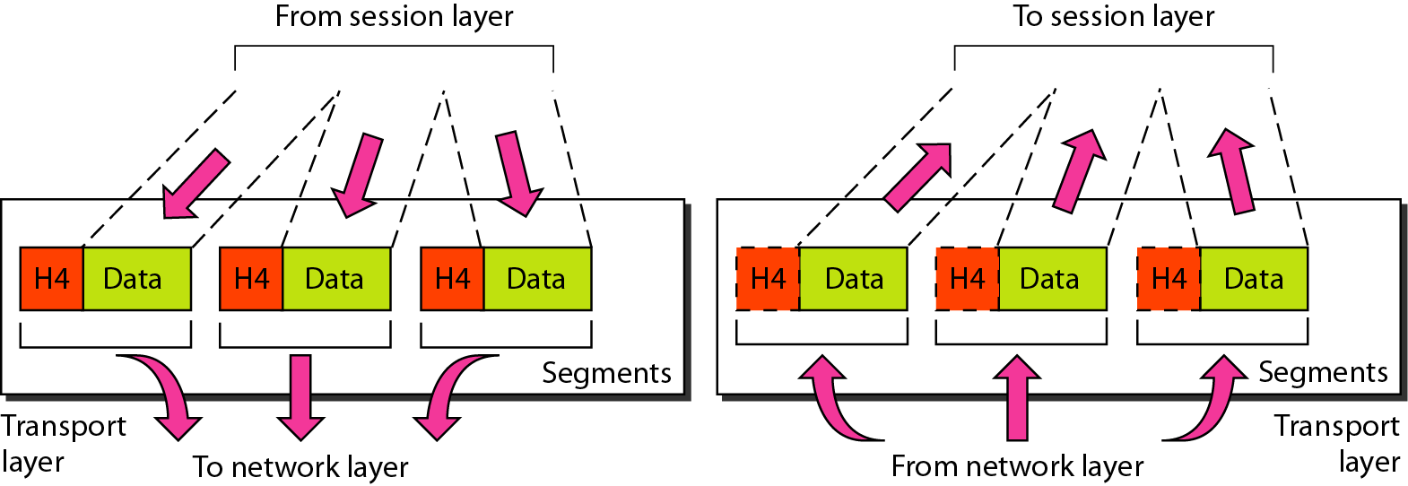
Segmentation and Reassembly
Transport layer

Slide 63
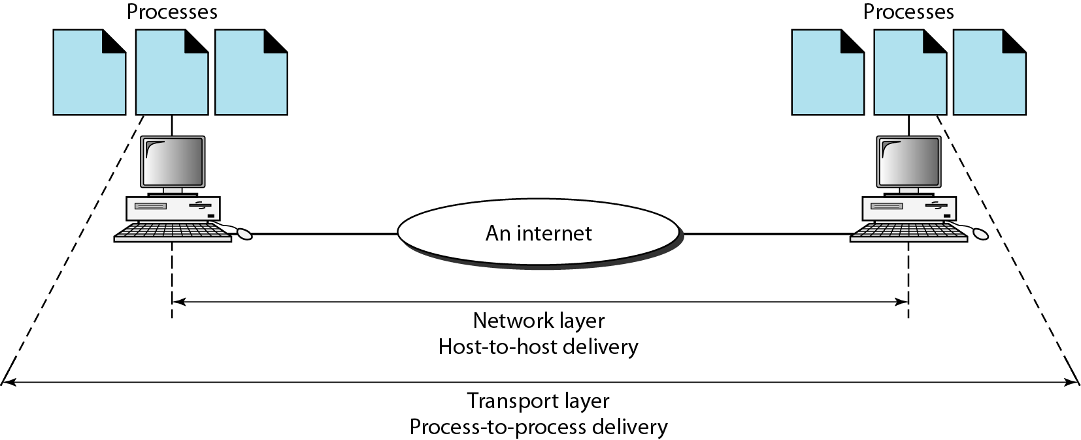
Reliable process-to-process delivery of a message

Slide 64
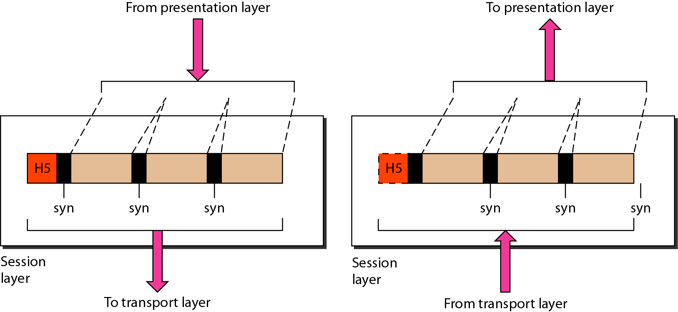
Session layer
Its function is to maintain a “conversation” across multiple related message exchanges between two hosts (called session), to keep track of the progress of their communication.
This layer establishes, authenticates, manages, and terminates sessions. Example services include keeping track of whose turn it is to transmit (dialog control) and checkpointing long conversations to allow them to resume after a crash.

Slide 65
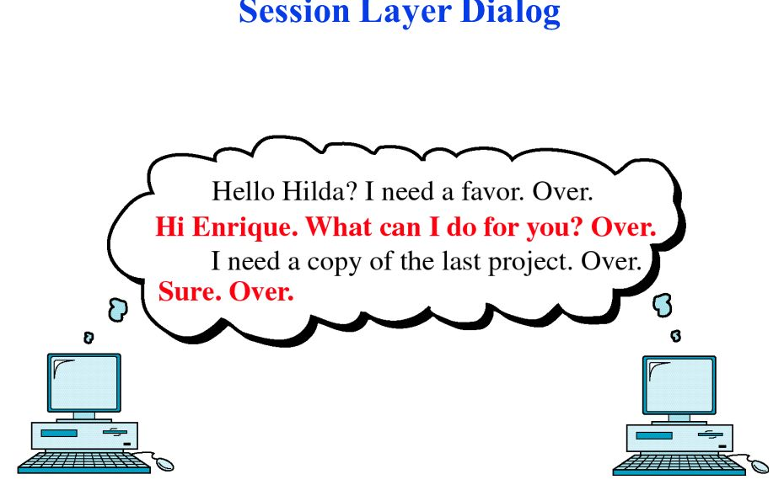
Session layer
PROTOCOLS USED:
NetBIOS, PPTP (Point-to-Point Tunneling Protocol ), NCP (NetWare Core Protocol)

Slide 66
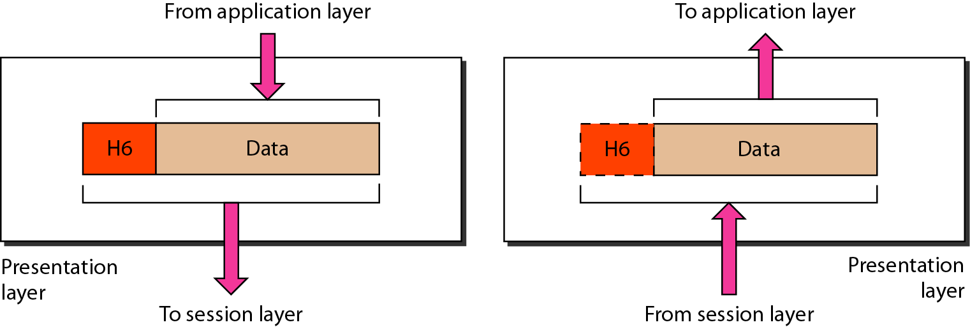
Presentation layer
The presentation layer is responsible for translation, compression, and encryption.

Slide 67
Presentation layer
PROTOCOLS USED:
ASCII (American Standard Code for Information Interchange)
EBCDIC (Extended Binary Coded Decimal Interchange Code) ,
JPEG (Joint Photographic Experts Group)
MPEG (Moving Pictures Experts Group)

Slide 68
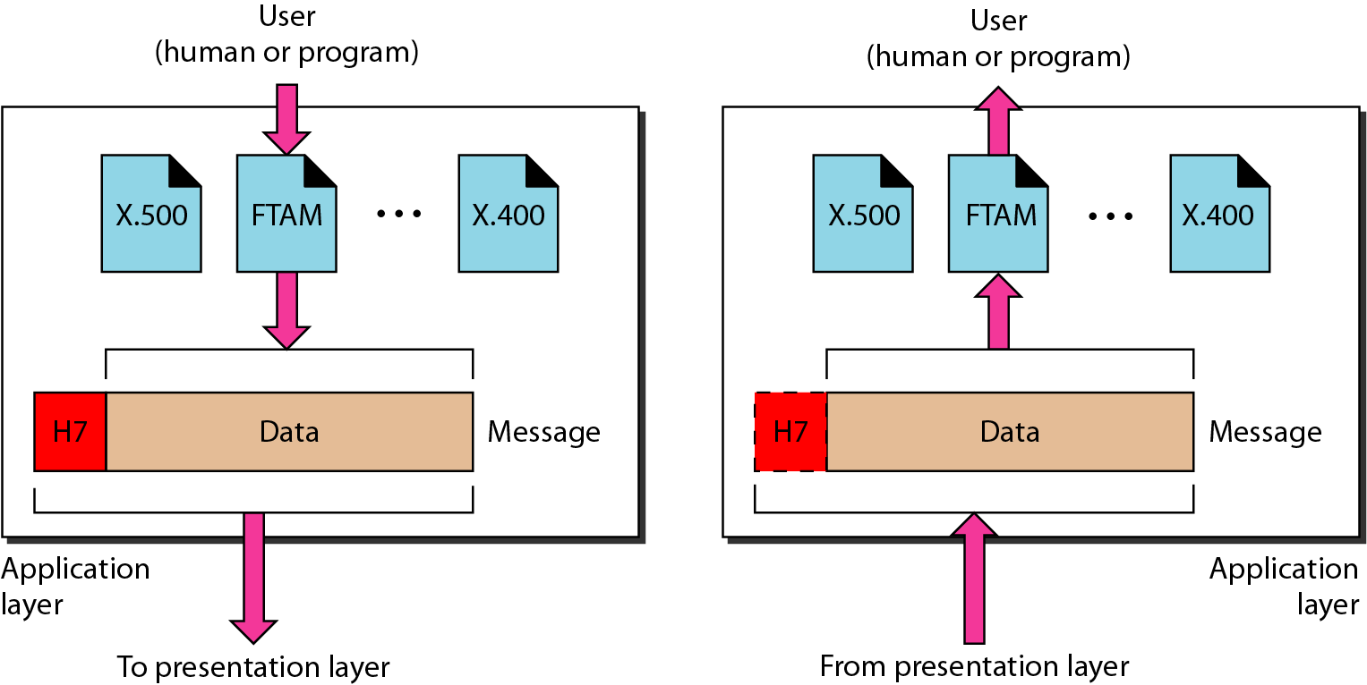
Application layer
The application layer is responsible for providing services to the user.

Slide 69
Application layer
PROTOCOLS USED:
Telnet (Remote login to hosts)
DNS (Domain Name System)
DHCP (Dynamic Host Configuration Protocol )
FTP (File Transfer Protocol)
HTTP (Hypertext Transfer Protocol)
SMTP (Simple Mail Transfer Protocol )
SNTP (Simple Network Time Protocol)

Slide 70
Crossover | A crossover cable, occasionally called crossed cable, connects two Ethernet network devices to each other. They were created to support temporary host-to-host networking in situations where an intermediate device like a network router is not present.
100BASE-T | 100BASE-T is an enhanced form of Ethernet 10BASE-T and a network standard used for fast data transfer rates up to 100 Mbps
Ethernet | Ethernet, is the standard way to connect computers on a network over a wired connection. It provides a simple interface and for connecting multiple devices, such computers, routers, and switches.
ATM | Asynchronous transfer mode (ATM) is a switching technique used by telecommunication networks that uses asynchronous time-division multiplexing to encode data into small, fixed-sized cells.
Frame relay | Frame relay is a data link layer, digital packet switching network protocol technology designed to connect Local Area Networks (LANs) and transfer data across Wide Area Networks (WANs).
NetBIOS | NetBIOS (Network Basic Input/Output System) is a program that allows applications on different computers to communicate within a local area network (LAN).
PPTP | The Point-to-Point Tunneling Protocol (PPTP) is a method for implementing virtual private networks, with many known security issues.

Slide 71
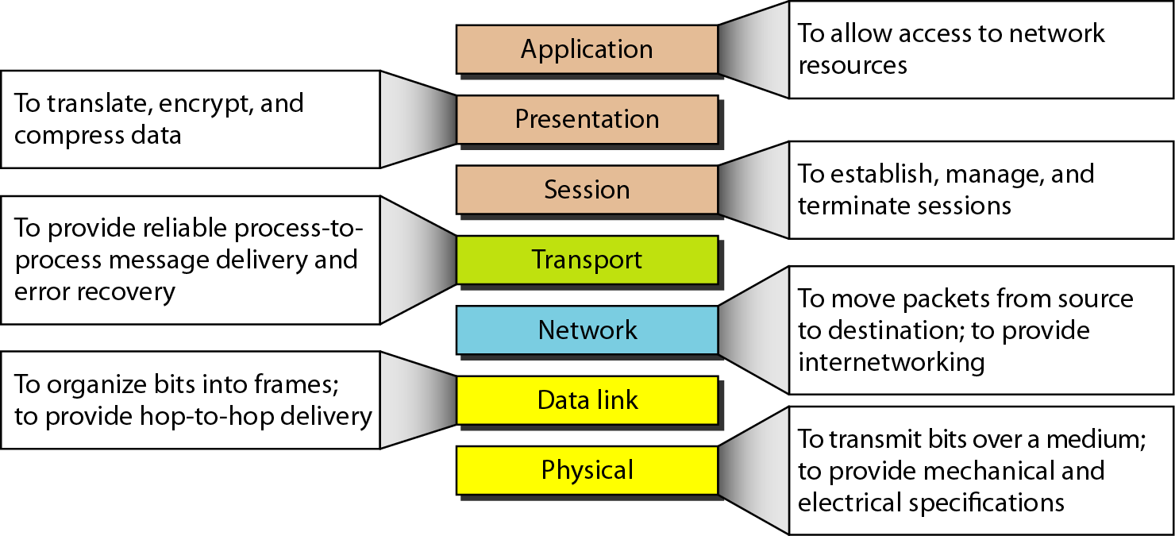
Summary of layers

Slide 72
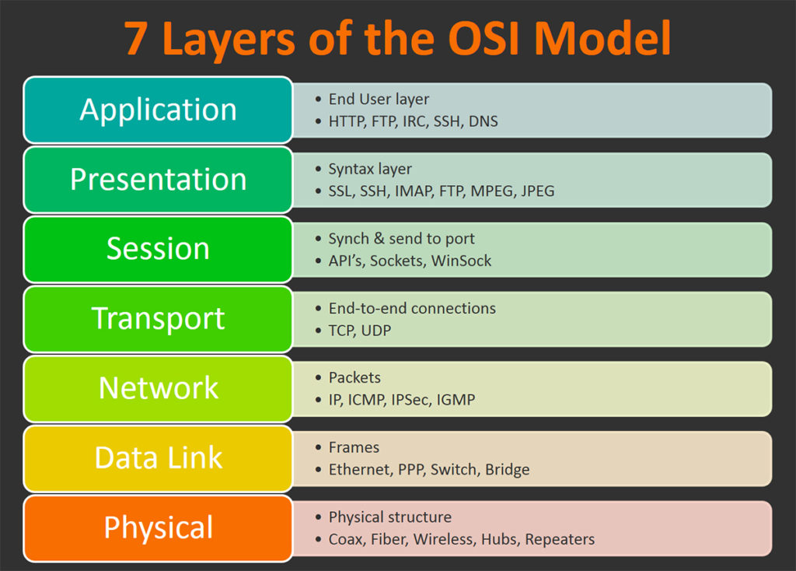
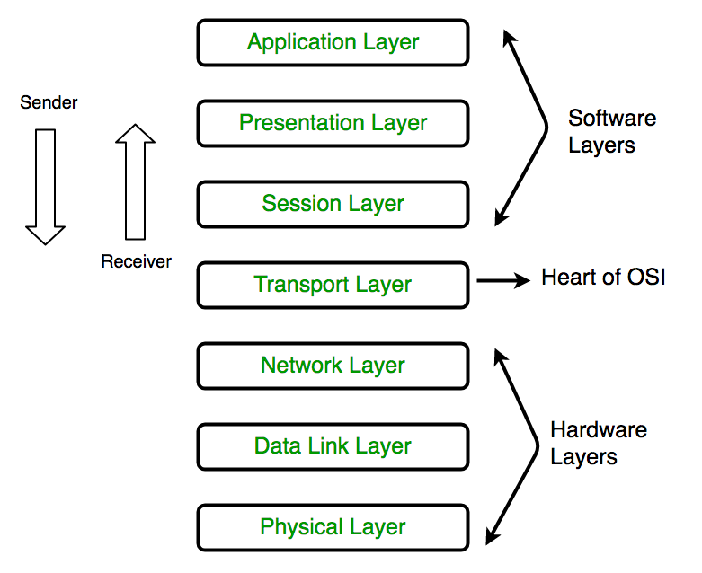

Slide 73
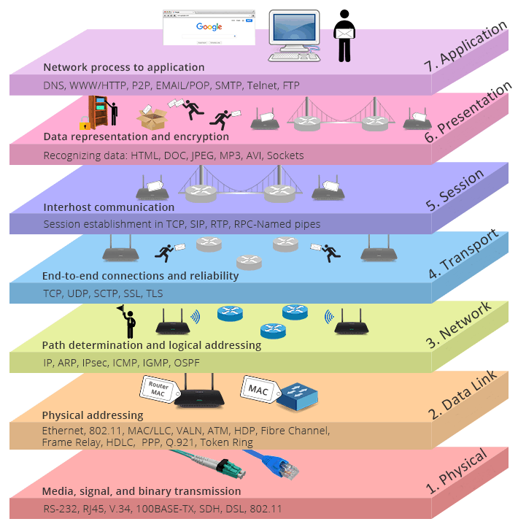

Slide 74
TCP/IP PROTOCOL SUITE
The layers in the TCP/IP protocol suite do not exactly match those in the OSI model. The original TCP/IP protocol suite was defined as having four layers: host-to-network, internet, transport, and application.
However, when TCP/IP is compared to OSI, we can say that the TCP/IP protocol suite is made of five layers:
physical
data link
Internet
transport
application.

Slide 75
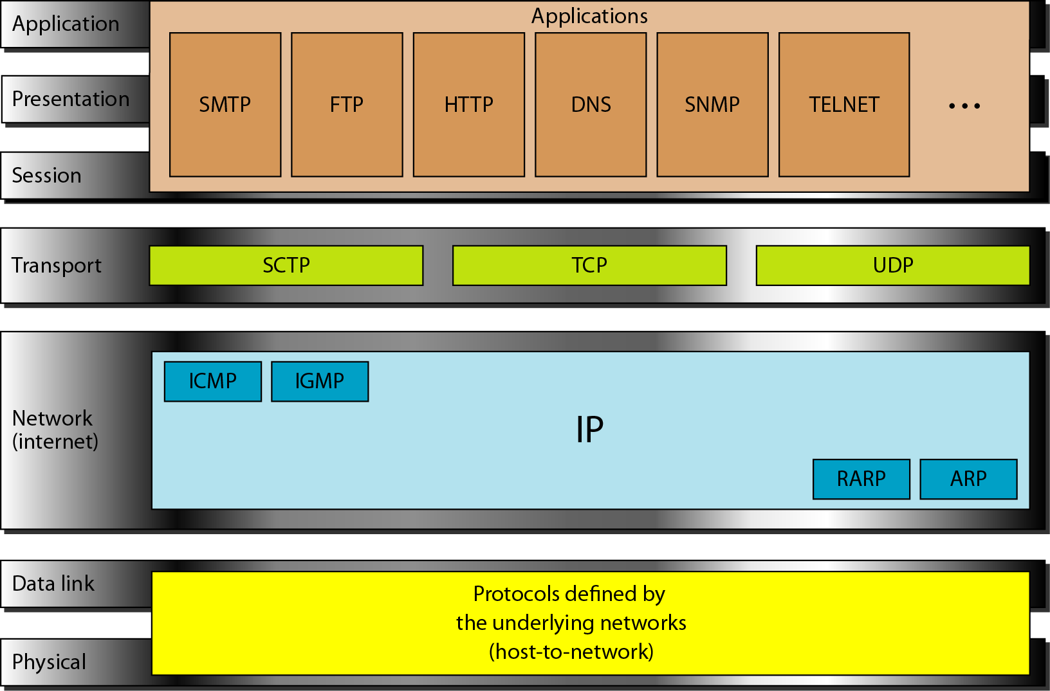
TCP/IP and OSI model

Slide 76
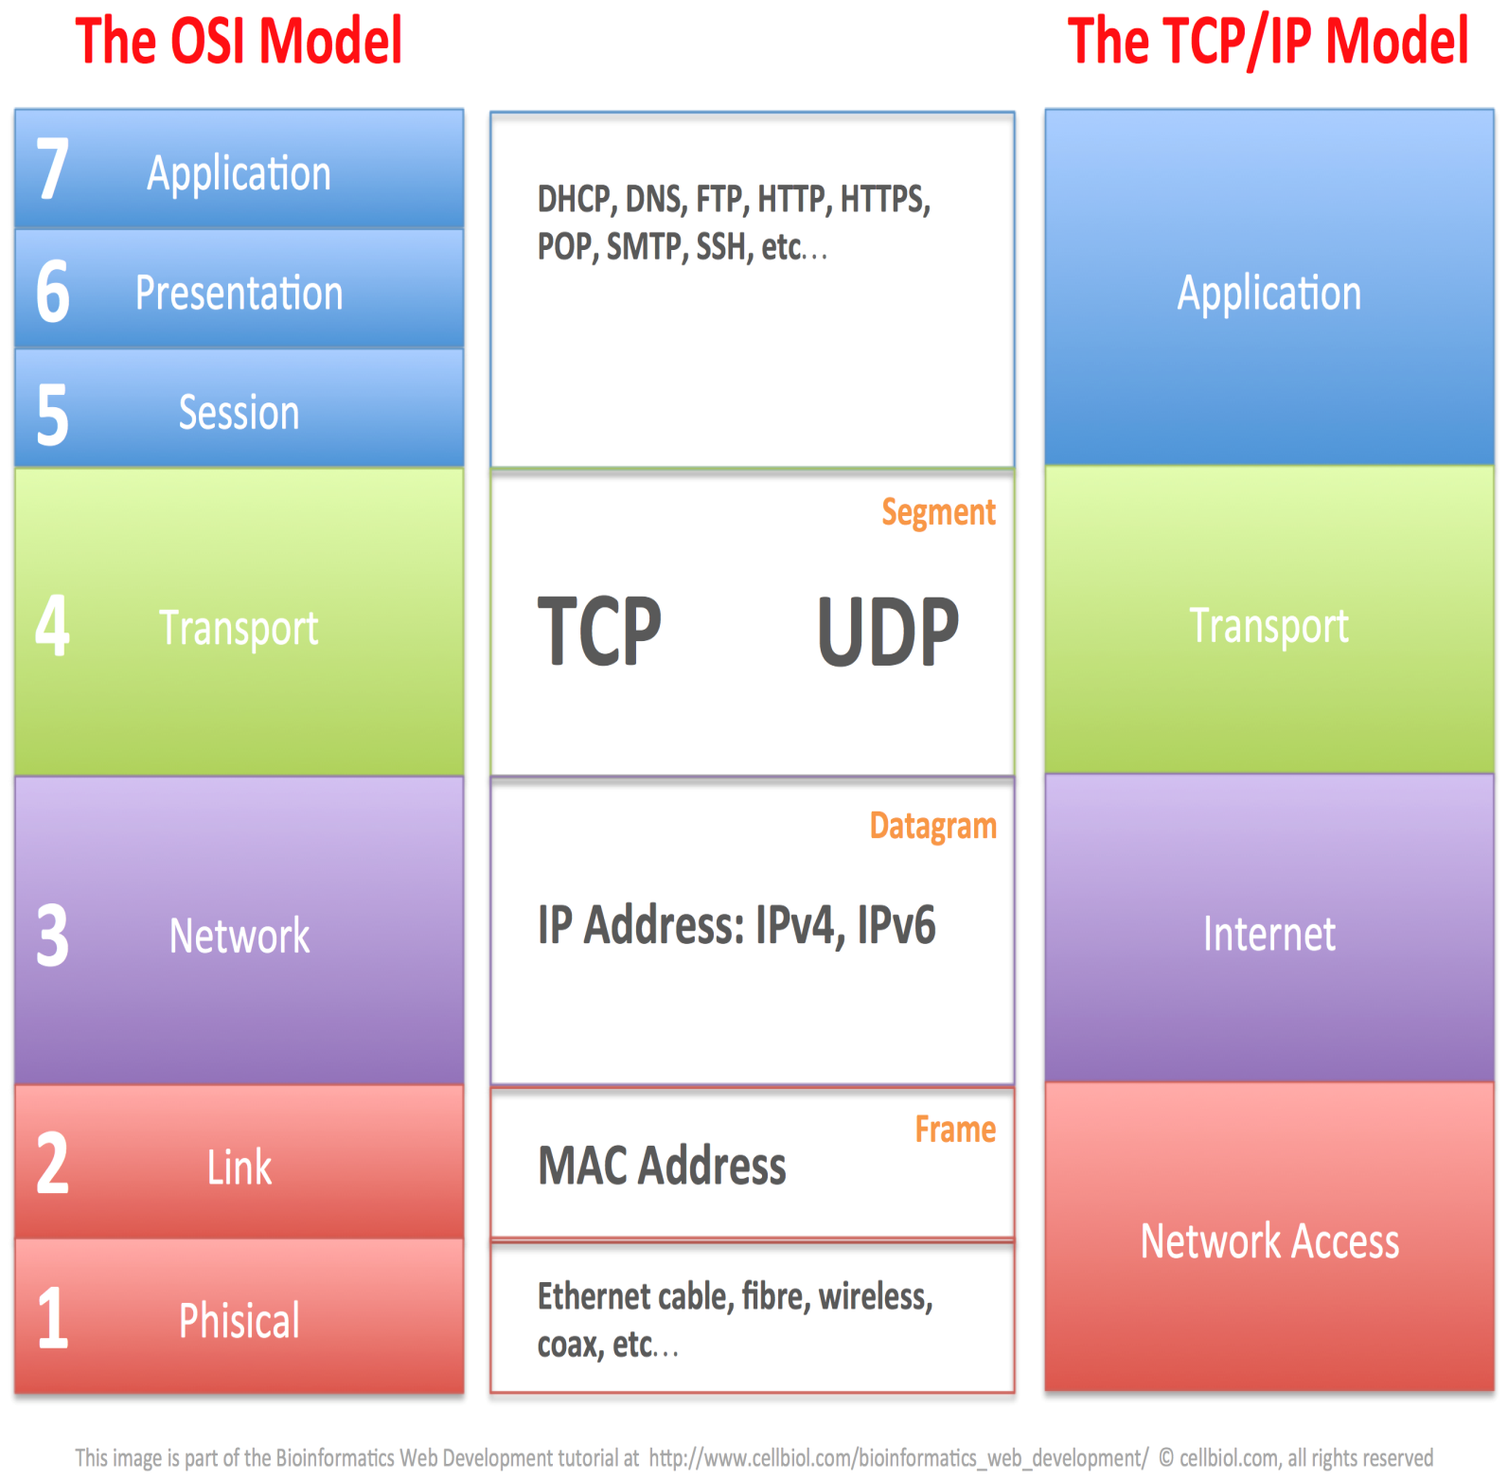

Slide 77
Network Interface Layer/Network Access(Host to Network)
The Network Interface layer (also called the Network Access layer) sends TCP/IP packets on the network medium and receives TCP/IP packets off the network medium.
TCP/IP was designed to be independent of the network access method, frame format, and medium.
Therefore, you can use TCP/IP to communicate across differing network types that use LAN technologies—such as Ethernet and 802.11 wireless LAN—and WAN technologies—such as Frame Relay and Asynchronous Transfer Mode (ATM).
By being independent of any specific network technology, TCP/IP can be adapted to new technologies.

Slide 78
Internet Layer
The Internet layer responsibilities include addressing, packaging, and routing functions. The Internet layer is analogous to the Network layer of the OSI model.
The core protocols for the TCP/IP Internet layer consist of the following:
Address Resolution Protocol (ARP) -resolves the Internet layer address to a Network Interface layer address such as a hardware address.
The Internet Protocol (IP) -is a routable protocol that addresses, routes, fragments, and reassembles packets.IPv4,IPv6.
The Internet Control Message Protocol (ICMP) reports errors and other information to help you diagnose unsuccessful packet delivery.
The Internet Group Management Protocol (IGMP) manages IP multicast groups.

Slide 79
Transport Layer
The Transport layer (also known as the Host-to-Host Transport layer) is responsible for providing the Application layer with session and datagram (header+payload) communication services. The core protocols of the Transport layer are Transmission Control Protocol (TCP) and the User Datagram Protocol (UDP).
TCP
one-to-one
connection-oriented
reliable communications service
the sequencing and acknowledgment of packets sent.
recovery of packets lost during transmission.
UDP
one-to-one or one-to-many
connectionless
unreliable communications service.
UDP is used when the amount of data to be transferred is small (such as the data that would fit into a single packet
when the overhead of establishing a TCP connection is not desired or when the applications or upper layer protocols provide reliable delivery.
The Transport layer encompasses the responsibilities of the OSI Transport layer and some of the responsibilities of the OSI Session layer.

Slide 80
Application Layer
The Application layer provides applications the ability to access the services of the other layers and defines the protocols that applications use to exchange data. There are many Application layer protocols and new protocols are always being developed.
The most widely-known Application layer protocols are those used for the exchange of user information:
The Hypertext Transfer Protocol (HTTP) is used to transfer files that make up the Web pages of the World Wide Web.
The File Transfer Protocol (FTP) is used for interactive file transfer.
The Simple Mail Transfer Protocol (SMTP) is used for the transfer of mail messages and attachments.
Telnet, a terminal emulation protocol, is used for logging on remotely to network hosts.
Additionally, the following Application layer protocols help facilitate the use and management of TCP/IP networks:
The Domain Name System (DNS) is used to resolve a host name to an IP address.
The Routing Information Protocol (RIP) is a routing protocol that routers use to exchange routing information on an IP internetwork.
The Simple Network Management Protocol (SNMP) is used between a network management console and network devices (routers, bridges, intelligent hubs) to collect and exchange network management information.
Examples of Application layer interfaces for TCP/IP applications are Windows Sockets and NetBIOS

Slide 81
Physical Address, Logical Address and Port Address
Physical address(MAC : Media Access Control): Each system having a NIC(Network Interface Card). This is specified by the manufacture company of the card. This address is used by data link layer.
07:01:02:01:2C:4B, A 6-byte (12 hexadecimal digits) physical address
Logical Address: An IP address of the system is called logical address. This address is the combination of Net ID and Host ID. This address can be changed by changing the host position on the network. So it is called logical address. Used in Network layer.
An IP address (IPv4) consists of four decimal numbers separated by period.130.57.64.11
Port Address: There are many application running on the computer. Each application run with a port no.(logically) on the computer. This port no. for application is decided by the Kernel of the OS. This port no. is called port address.
753, 8080 etc.: 16-bit port address represented as one number
Socket Address: Process to process delivery (transport layer communication) needs two identifiers, one is IP address and the other is port number at each end to make a connection.
Socket address is the combinations of IP address and port number as shown:
192.168.10.4 (IP):8080 (Port Number)

Slide 82
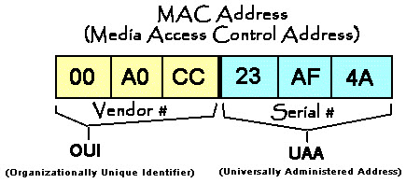
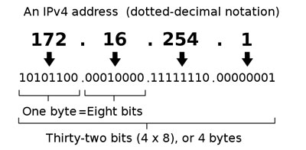




128 -Bit scheme (16 byte),
each field 16-bit
8-bit (1-byte) each field

Slide 83
Comparison Between OSI and TCP/IP

Slide 84
Comparison Between OSI and TCP/IP-contd.

Slide 85
OSI(Open System Interconnection) | TCP/IP(Transmission Control Protocol / Internet Protocol)
1. OSI is a generic, protocol independent standard, acting as a communication gateway between the network and end user. | 1. TCP/IP model is based on standard protocols around which the Internet has developed. It is a communication protocol, which allows connection of hosts over a network.
2. In OSI model the transport layer guarantees the delivery of packets. | 2. In TCP/IP model the transport layer does not guarantees delivery of packets. Still the TCP/IP model is more reliable.
3. Follows vertical approach. | 3. Follows horizontal approach.
4. OSI model has a separate Presentation layer and Session layer. | 4. TCP/IP does not have a separate Presentation layer or Session layer.
5. Transport Layer is Connection Oriented. | 5. Transport Layer is both Connection Oriented and Connection less.
6. Network Layer is both Connection Oriented and Connection less. | 6. Network Layer is Connection less.
7. OSI is a reference model around which the networks are built. Generally it is used as a guidance tool. | 7. TCP/IP model is, in a way implementation of the OSI model.
8. OSI model has a problem of fitting the protocols into the model. | 8. TCP/IP model does not fit any protocol
9. Protocols are hidden in OSI model and are easily replaced as the technology changes. | 9. In TCP/IP replacing protocol is not easy.
10. OSI model defines services, interfaces and protocols very clearly and makes clear distinction between them. It is protocol independent. | 10. In TCP/IP, services, interfaces and protocols are not clearly separated. It is also protocol dependent.
11. It has 7 layers | 11. It has 4 layers

Slide 86

Network Topology
The network topology defines the way in which computers, printers, and other devices are connected.
A network topology describes the layout of the wire and devices as well as the paths used by data transmissions.
Types-
Basic Topologies:
Bus
Ring
Star
Mesh
Derived Topologies
Tree
Hybrid

Slide 87

Bus topology
No. of Links: 1 cable (backbone) and n droplines (links)
No.of I/O Ports: 1 (1 neighbour)
Advantages of Bus Topology
Works well for small networks
Relatively inexpensive to implement
Easy to add to it
Disadvantages of Bus Topology
Management costs can be high
Potential for congestion with network traffic

Slide 88

Ring Topology
No. of Links: n
No.of I/O Ports: 2 (2 neighbours)
Advantages of Ring Topology
Easier to manage; easier to locate a defective node or cable problem
Well-suited for transmitting signals over long distances on a LAN
Handles high-volume network traffic
Enables reliable communication
Disadvantages of Ring Topology
Expensive
Requires more cable and network equipment at the start
Not used as widely as bus topology
Fewer equipment options
Fewer options for expansion to high-speed communication

Slide 89

Star Topology
No. of Links: n
No. of I/O Ports: 1 (1 neighbour i.e only hub)
Advantages of Star Topology
Good option for modern networks
Low startup costs
Easy to manage
Offers opportunities for expansion
Most popular topology in use; wide variety of equipment available
Disadvantages of Star Topology
Hub is a single point of failure
Requires more cable than the bus

Slide 90

Mesh Topology
No. of Links: n(n-1) simplex links, n(n-1)/2 duplex*
No. of I/O Ports: n-1 (n-1 neighbours)
A mesh network is a network topology in which each node relays data for the network. All mesh nodes cooperate in the distribution of data in the network.
Mesh networks can relay messages using either a flooding technique or a routing technique.
Advantages
Less Traffic
Reliability
Ever growing
Disadvantages
Highly expensive
High maintenance
*=duplex required single wire for both ways communication ,
so it is equal to total number of edges
But simplex will require two wires for both ways communication,
one for each direction ,so it will require the double of duplex.

Slide 91
For ‘n’ devices in a network, the number of cable links required for a mesh, ring, bus, and star topology:
Mesh: n * (n-1) / 2
Ring: n
Bus: n + 1 (n for cables, 1 for backbone)
Star: n

Slide 92
Question: Assume six devices are arranged in a mesh topology. How many cables are needed? How many ports are needed for each device?
Solution: Cables needed=n * (n-1)/2 = 6 * 5 / 2 = 15 cables.
Number of devices connected per device = n-1 = 5, so number of ports per device = 5.

Slide 93

Derived Topology-Tree Topology
A Tree topology is a combination of two or more star topology connected together by central bus backbone or star backbone.
The tree topology is ideal when the workstations are located in groups, with each group occupying a relatively small physical region.
Advantages and Disadvantages
Same as Star and Bus topology

Slide 94

Derived Topology-Hybrid Topology
A hybrid topology is a type of network topology that uses two or more other network topologies, including bus topology, mesh topology, ring topology, star topology, and tree topology.
Advantages of Hybrid Network Topology
1) Reliable : Unlike other networks, fault detection and troubleshooting is easy in this type of topology.
2) Scalable: Its easy to increase the size of network by adding new components, without disturbing existing architecture. 3) Flexible: Hybrid Network can be designed according to the requirements of the organization and by optimizing the available resources. 4) Effective: Hybrid topology is the combination of two or more topologies, so we can design it in such a way that strengths of constituent topologies are maximized while there weaknesses are neutralized.
Disadvantages of Hybrid Topology
1) Complexity of Design: One of the biggest drawback of hybrid topology is its design. Its not easy to design this type of architecture and its a tough job for designers. Configuration and installation process needs to be very efficient. 2) Costly Hub: The hubs used to connect two distinct networks, are very expensive. These hubs are different from usual hubs as they need to be intelligent enough to work with different architectures and should be function even if a part of network is down. 3) Costly Infrastructure: As hybrid architectures are usually larger in scale, they require a lot of cables, cooling systems, sophisticate network devices, etc.

Slide 95
Backbone Networks
A backbone is a part of computer network that interconnects various pieces of network, providing a path for the exchange of information between different LANs and subnetworks.
A backbone can tie together diverse networks in the same building, in different buildings in a campus environment, or over wide areas. Normally, the backbone's capacity is greater than the networks connected to it.

Slide 96
BACKBONE NETWORKS
A backbone network allows several LANs to be connected. In a backbone network, no station is directly connected to the backbone; the stations are part of a LAN, and the backbone connects the LANs.
Examples:
Bus Backbone Star Backbone

Slide 97


In a bus backbone, the topology of the backbone is a bus.
In a star backbone, the topology of the backbone is a star;
the backbone is just one switch.

Slide 98

Backbone Networks: Serial Backbone
Daisy chain: linked series of devices
Hubs and switches often connected in daisy chain to extend a network
Hubs, gateways, routers, switches, and bridges can form part of backbone

Slide 99

Backbone Networks: Distributed Backbone
A distributed backbone is a backbone network that consists of a number of connectivity devices connected to a series of central connectivity devices, such as hubs, switches, or routers, in a hierarchy.

Slide 100

Backbone Networks: Collapsed Backbone
A network configuration that provides a backbone in a centralized location, to which all subnetworks are attached. A collapsed backbone is implemented in a router or switch that uses a high-speed backplane that can handle the simultaneous traffic of all or most of its ports at full wire speed.

Slide 101

Backbone Networks: Parallel Backbone
When organizations are looking for a very strong and trustworthy backbone they should choose a parallel backbone. This backbone is a variation of a collapsed backbone in that it uses a central node (connection point).

Slide 102

Hybrid Model-The Internet Model

Slide 103
The Internet today
The Internet today is an internetwork that allows any user to become part of it. The user, however, needs to be physically connected to an ISP. The physical connection is normally done through a point-to-point WAN.
1.103

